Slide 1
Assignment : 1
Module : 1 Understanding of Hardware and Its Components

Slide 2
Section: 1 Multiple Choice
1. Which of the following is NOT a component of the CPU?
Ans : RAM
2. What is the function of RAM in a computer?
Ans : RAM is Temporary storage memory. That’s a CPU need a best performing. Ram was a fast performing and respomsivness of the system.Ram was Buffering time to stored in data . Ram was a CPU and input and output helping in transfer a data.
RAM Type : DDR1,DDR2,DDR3,DDR4 And DDR5.
DDR 5Was latest Ram in Genration. That’s a 32GB Speed to work it.
Normaly User can use in DDR3 and DDR4.

Slide 3
Section: 1 Multiple Choice
3. Which of the following is a primary storage device?
Ans : HDD And SD Card
4. What is the purpose of a GPU?
Ans : GPU was a Graphics Unit. That’s a one type of graphics card .
GPU was conected in PCI and PCIe. That’s a VGA port threw showed in display.
Few time not power supply in motherboard but tharts a directly power inserting . GPU was a fast and better output will be share in display.

Slide 4
Section 2 : True or False
5. The motherboard is the main circuit board of a computer where other components are attached.
Ans : True
6. A UPS (Uninterruptible Power Supply) is a hardware device that provides emergency power to a load when the input power source fails.
Ans : True
7. An expansion card is a circuit board that enhances the functionality of a component.
Ans : True

Slide 5
Section 3 : Short Answer
8. Explain the difference between HDD and SSD.
Ans :
HDD :- Use Spining magnatic disks to read and write data. That’s a Genrally Slow read and write data. That’s a lower life span in Compared to SSD. Genrally avablity in larger capacities for lower price. That a produce in heat , requires additional cooling.
SSD :- Use flashe memory to store in data , with no moving parts. That’s a genrally work in faster access. That’s a faster access to read and write to 500 MbPs to 7000 MbPs more for SSD. Expensive per Gigabyte price have been decreasing over time.That a generate in less heat.

Slide 6
Section 3 : Short Answer
9. Describe the function of BIOS in a computer system ?
Ans :
POST :- Test the computer hardwaer and sure no error before the operating system.
Bootstarp Loader :- If a capable in operating system is located the BIOS will pass.
BIOS Driver :- Low level drivers that give the control in Your computer hardware.
BIOS and CMOS Setup :-Configration program that allows you to configure hardware. That’s a showed in reall time to work it.

Slide 7
Section 3 : Short Answer
10. List and briefly explain three input devices commonly used with computers?
Ans :
Keyboard :- A keyboard is a device that allows users to input text and commands into a computer. Keyboards can be wired or wireless and may come with additional features like backlighting or programmable keys.
Mouse :- A mouse is a pointing device that lets users interact with the graphical user interface (GUI) of a computer. It typically features buttons and a scroll wheel, allowing for precise movements and selections on the screen.
Scanner :-A scanner is a device that converts physical documents and images into digital format. Users place a document on the scanner's glass surface, and it uses light and sensors to capture the image.

Slide 8
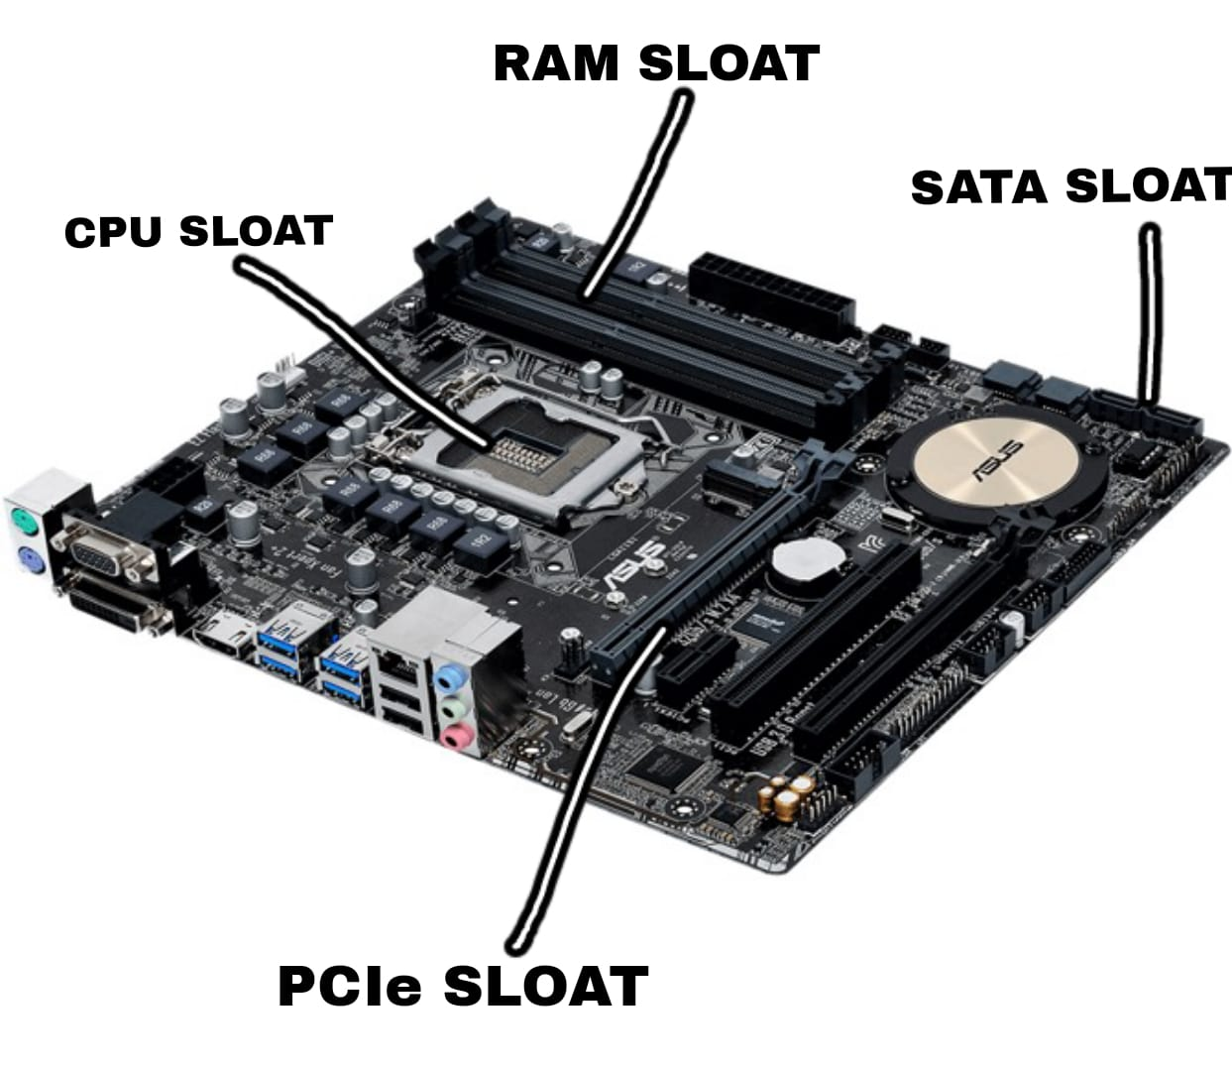
Section 4 : Practical Application
11. Identify and label the following components on a diagram of a motherboard: ● CPU ● RAM slots ● SATA connectors And PCIe Sloat?
Ans :

Slide 9
Section 4 : Practical Application
CPU :- The CPU is usually located near the center of the motherboard Often covered by fan cooling. Its a square chip with many pins or connect pads on the underside.
RAM Sloat :- RAM Sloat a typically locketed the CPU socket. They are long narrow sloat you install RAM Module.
SATA Conecter :- SATA connecter are use in connect the harddrive and SSD in motherboard.
PCIe-Sloat :- PCIe-sloat areexpension sloat use to install graphics card ,sound card and other expension card.

Slide 10
Section 4 : Practical Application
12. Demonstrate how to install a RAM module into a computer?
Ans :
Step 1: Powet off the Computer
Step 2: Open the Computer Case
Step 3: Locate the Ram Sloat
Step 4: Remove Exiting RAM
Step 5: Prepare the New RAM module
Step 6: Insert the RAM module
Step 7: Reesamble the Computer case
Step 8: Reconect the Power And Bootup
Step 9: Check install RAM

Slide 11
Section 5 : Essay
13. Discuss the importance of proper cooling mechanisms in a computer system. Include examples of cooling methods and their effectiveness?
Ans : Over Heating generate to prosessor are close. Processor are maintain to use in cooling system. Over heating to system will be crase. To cooling system are very important part in CPU.
Two Type of Cooling method :-
1. Air Cooler
2. Liquide Cooler
Air Cooler :- This is the most common methond in cooling system. That’s use in Thermal past threw connect in Processor.
Liquide Cooler :- Liquide cooling system will be use in Highe processor to cooling procecing to use. Like i7 Processor to cooling maintain best work in liquid cooler.

Slide 12
Section 4 : Practical Application
14. . Explain the concept of bus width and its significance in computer architecture.
Ans : The context of computer architecture specifically focusing on their rolse and function.
CU (Control Unint) :- The control unit is the critical componenets of the CPU responsible for directing the operation of the processor. The CU is retrieves instruction from memory.
ALU(Arethmetic Logical Unit) :- The arithmetic logical unit is a fundamental building block of the CPU that perform arithmetic and Logic operations. ALU is basic operation are addition , aubtrictio , maultiplication and division. Logical operatior are basic in decision making work.

Slide 13
Section 4 : Practical Application
3. MU (Memory Unit) :- The memory unit system was responsibale in storing a data .
L1 Cache :- L1Cache size is 64KB. That’s a fast cache in memory. L1Cache is used to storing accessed data and intrutiones.
L2 Cache :- L2Cache size is 128KB. Thish is Cache slower than L1Cache but Faster than L3Cache. L2 is second tier of storing data and introduction.
L3 Cache :- L3Cache size is 256kB. The L3Cache is is a slower than L1Cache and L2Cache but that’s a larger than L1 and L2 cache.

